Slide 1
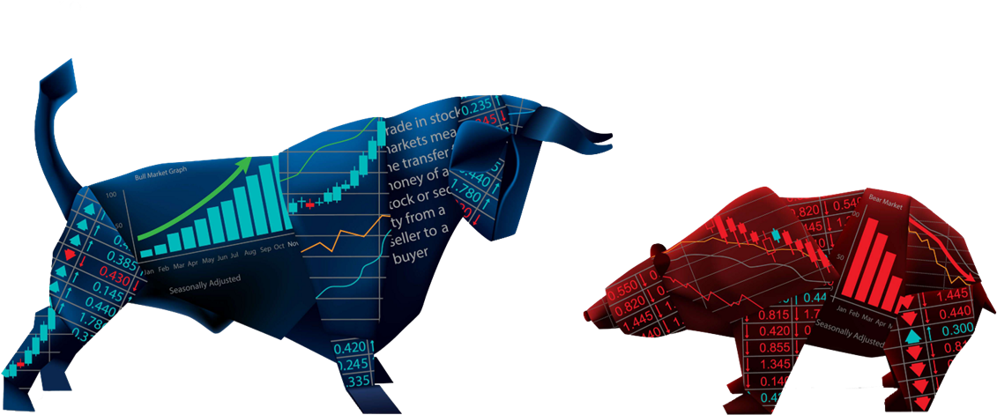
Stock Price Prediction
Lim Hwee Li (Data Scientist)
19th March 2022

Slide 2

Biography
Education
Graduated in Bachelor of Mechanical Engineering,
National University of Singapore (NUS)
Industry Certification on Data Science and Artificial Intelligence, Institute of Data (IOD)
Certified Project Management Professional (PMP), PMI
Professional Experience
**Disclaimer: Any idea or prediction displayed in this presentation only for presentation purposes and gathered from the general information researched. Please do your own research while investing**
Data Analytics
Agile Methodologies

Slide 3




Agenda
Project Context
Business Problem
Process Design
Delivery
Conclusion
Background
Problem Statement
Data Analysis
Results/Analysis
Recommendation
Discuss on stock market, volatility and why this project is interesting
Future stock price based on historical data and news
Design, exploratory analysis
Machine models used and sentimental analysis
Future steps for implementation and verification of predicted values

Slide 4
What is Stock Market?
Place where investors connect to buy and sell investments — most commonly, stocks, which are shares of ownership in a public company
Project Context

Slide 5
Project Context
How does Stock Market Works?
Govern by Demand and Supply – Plain and simple!
Increase in demand -> price will increase
Decrease n demand -> price will drop
Company raise money on the stock market by selling ownership stakes to investors for business continuity and funding
Investors exchange money for shares (part of company’s ownership)
Volatility (price fluctuations) affected by psychological factors (emotions)
BUY
SELL

Slide 6




Project Context
Why Invest?
Rising Cost of Living Same amount of cash cannot buy the same things as 10years ago. Value of money depreciates | Sense of Security More confident and less worry on unforeseen events in life
Financial Freedom Extra money means more opportunities, Having the ability to escape the rat race | Retirement Plan for retirement and rely lesser in the next generation

Slide 7
How can Stock Price be Predicted and what opportunities it can bring?
Business Problem

Slide 8






Business Problem
What is the Business Objective/ Problem Definition?
Data Driven insights
Understand the price trend, identify opportunities to buy and sell
Platforms
Open more business opportunities
Prediction of Stock Price
Ability to predict the future stock price of a company
Sentiment Analysis
Reduce unnecessary emotional and psychological stress
Value investing
Investing in the company value with a margin of safety
Social Welfare
General Public can increase in confident in their investment

Slide 9

Data Background,
Strategy implementation
Process Design

Slide 10









Process Design
Process Design
Data Cleaning
Split Training & Test Sets
Machine Learning (ML) Algorithms (Deep Learning Models)
Trading Strategy
Data Exploratory
Simulation
Data Preparation
Sentiment Analysis (Webscrapping)
Feature Selection

Slide 11
Process Design
DATA – Machine Learning
Data Source: Yahoo Finance API (NASDAQ: US Stock Exchange)
Company: Apple [NASDAQ: AAPL]
Machine Learning Algorithms: LSTM, ARIMA, SARIMA
Data Type: Time Series Data
Period:
Data Features:
Opening Value (Starting Value of the stock when market opens)
Highest and Lowest values of that stock (daily)
Closing Value (last value when market closes)
Adjusted Close Value (stock value after dividends have been declared)
Total Volume of the stocks

Slide 12
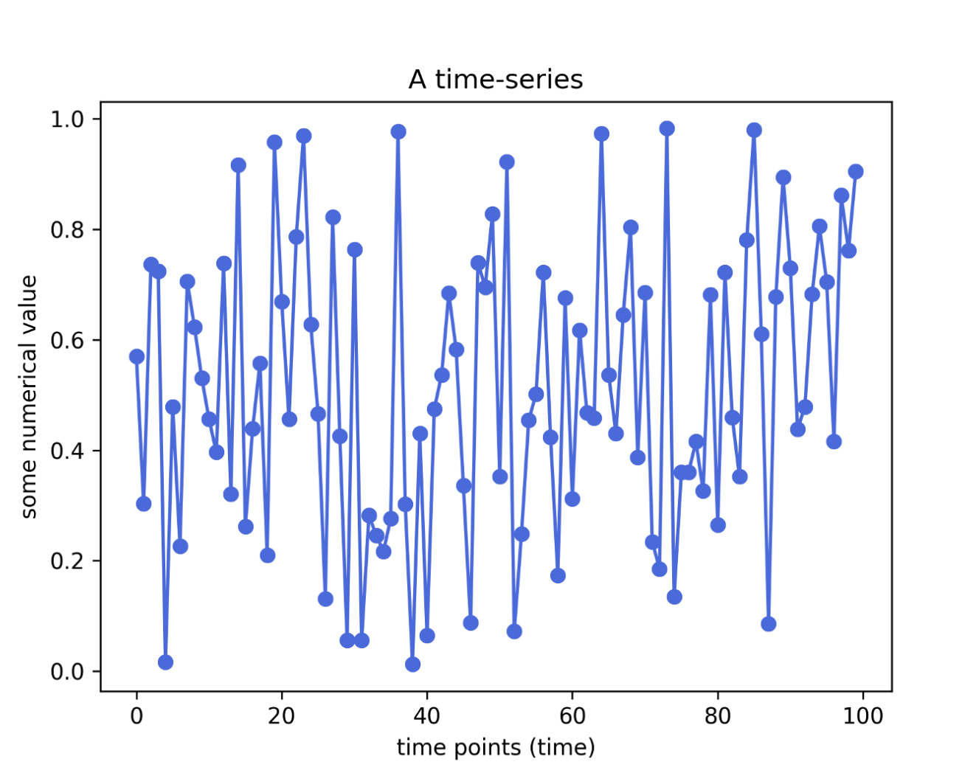
Process Design
What is Time Series?
Sequence of observations taken sequentially in time
No Natural Ordering of observations
Other examples:
Weather /Ocean Tides
Health evolution metrics (eg body temperature)

Slide 13
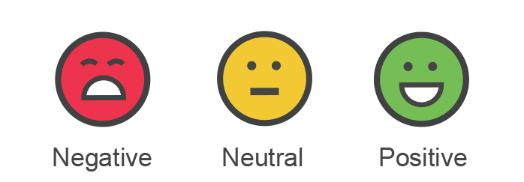
Process Design
DATA – Sentiment Analysis
Data Source: Finviz
Company: Apple [NASDAQ: AAPL]
Data Science Toolkit: Webscrapping (Beautiful Soup)
Data Features:
Time
News Reporter (Financial Websites)
New Headline (Subject of the News Article)
URL (website addresses)

Slide 14
Machine Learning Models and Sentiment Analysis
Delivery

Slide 15
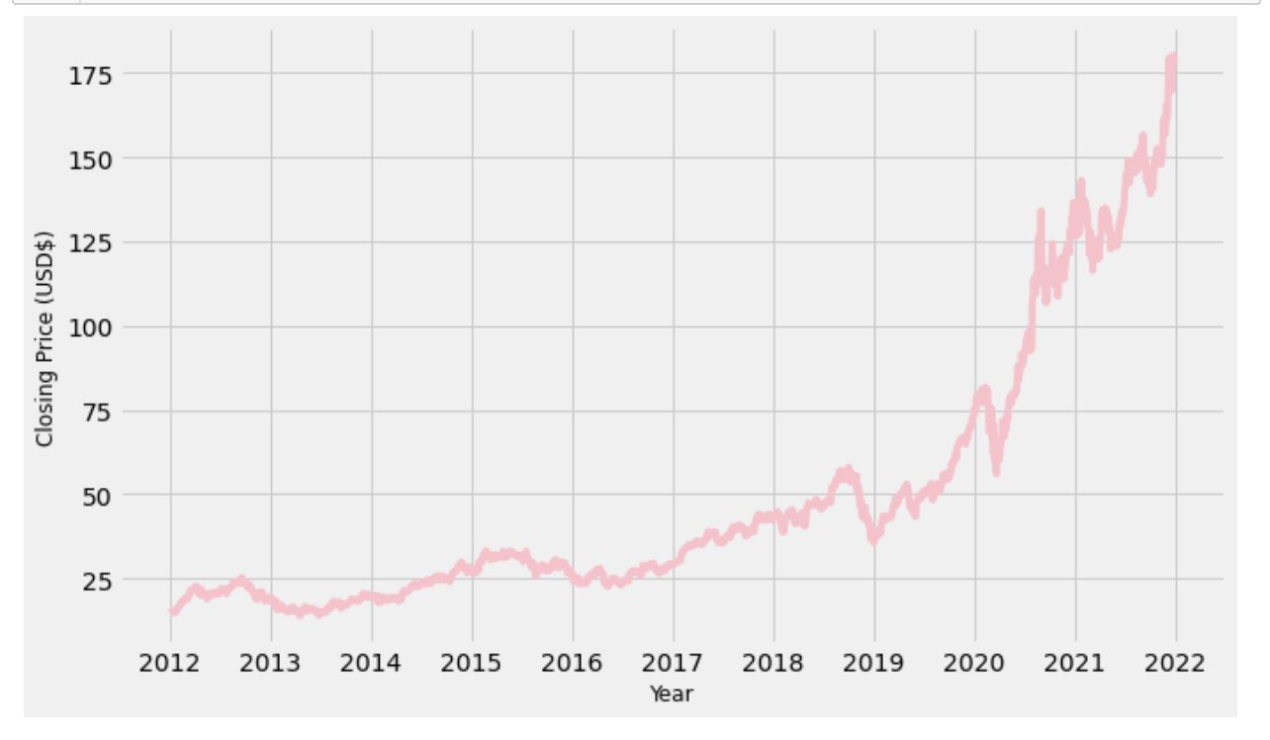
Delivery
Data Exploratory

Slide 16
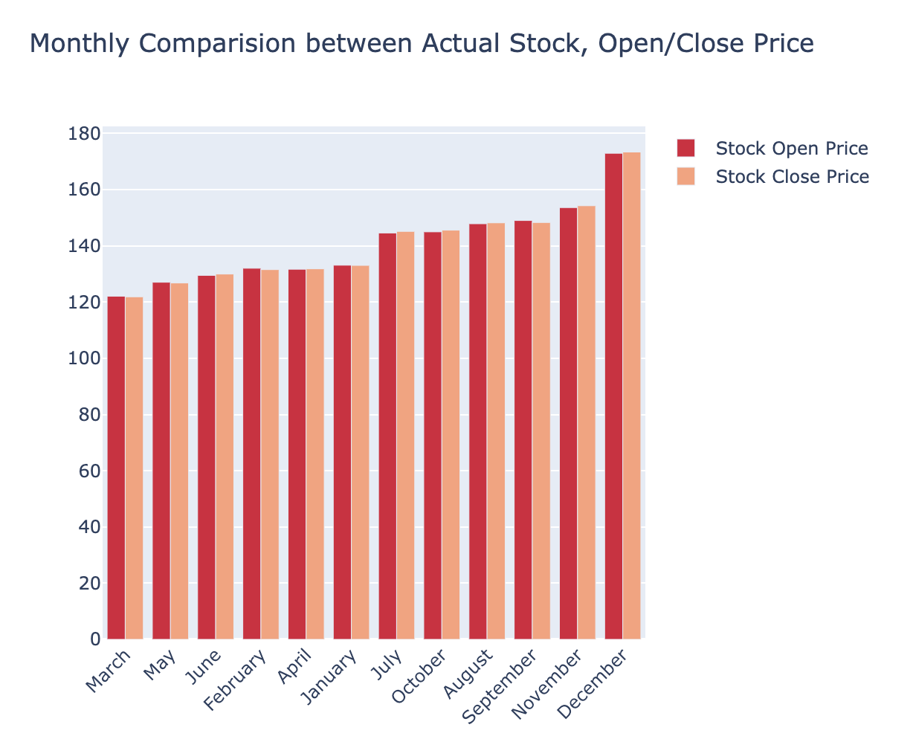
Delivery
Data Exploratory

Slide 17
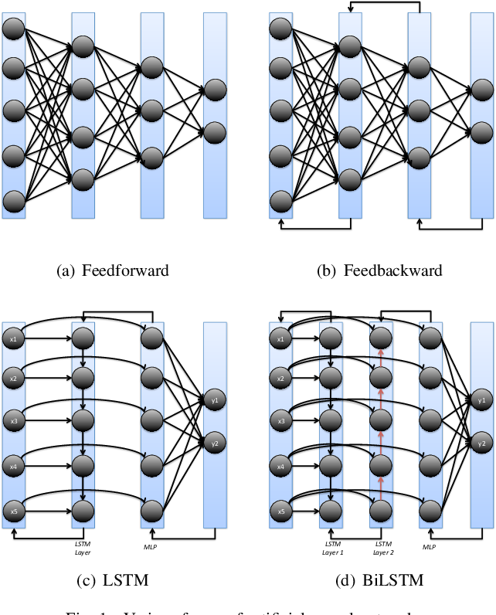
Delivery
ML Algorithms
– LSTM/ BiLSTM/ARIMA
Long Short Term Memory (LSTM)
Recurrent Neural Networks (RNN)
Predicting future values based on historical values
Short Term values
Bi-Directional Long Short Term Memory (BiLSTM)
Consists of 2 LSTM Models
Traversing the input data twice
Autoregressive Integrated Moving Average (ARIMA)
Statistical analysis model that uses time series data to predict future trends

Slide 18
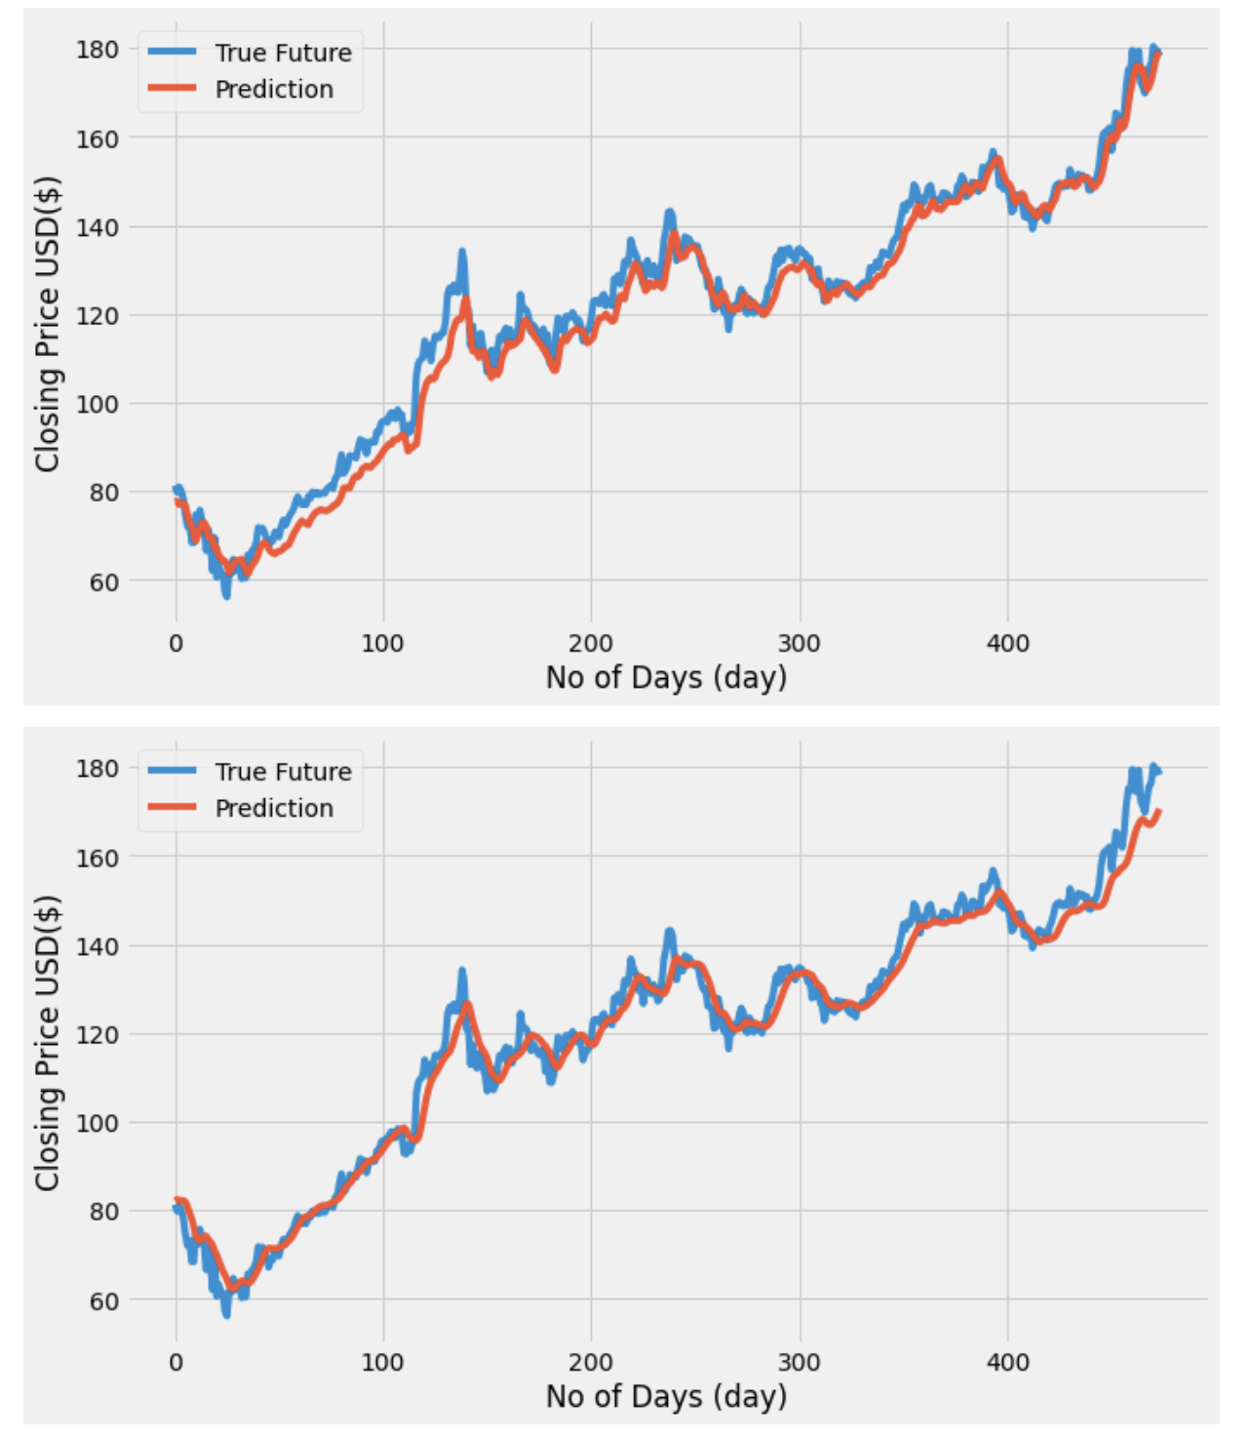
Delivery
ML Algorithms – LSTM/ BiLSTM
LSTM
BiLSTM

Slide 19
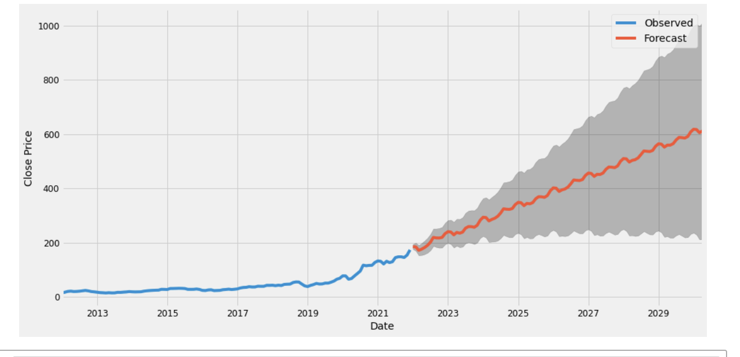
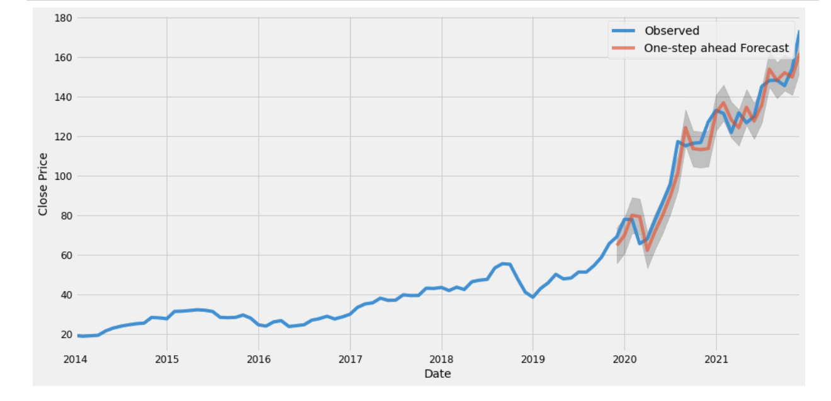
Delivery
ML Algorithms - ARIMA

Slide 20
Delivery
Comparison ML Algorithms
Model | MAE | RMSE | Average
LSTM | 3.3034 | 4.4279 | 3.8657
BiLSTM | 3.5580 | 4.4365 | 3.9973
ARIMA | 59.09 | 7.69 | 33.39
Best Model: LSTM
Definition:
MAE (Mean Averaged Error)
RMSE (Root Mean Square Error)

Slide 21



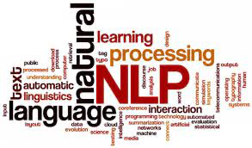
Delivery
Web Scrapping
Beautiful Soup
NTLK/ Textblob
Source: Finviz website
Company: Apple Inc(APPL)

Slide 22

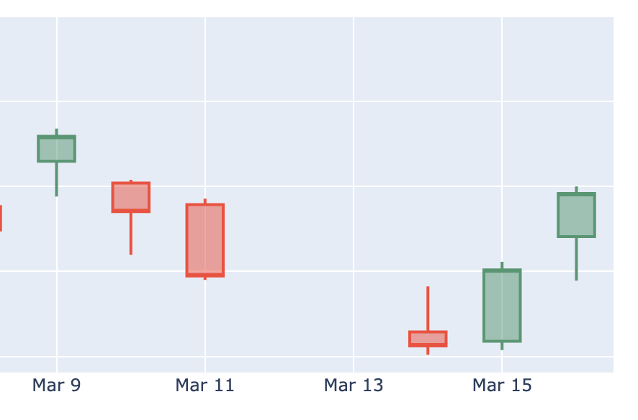


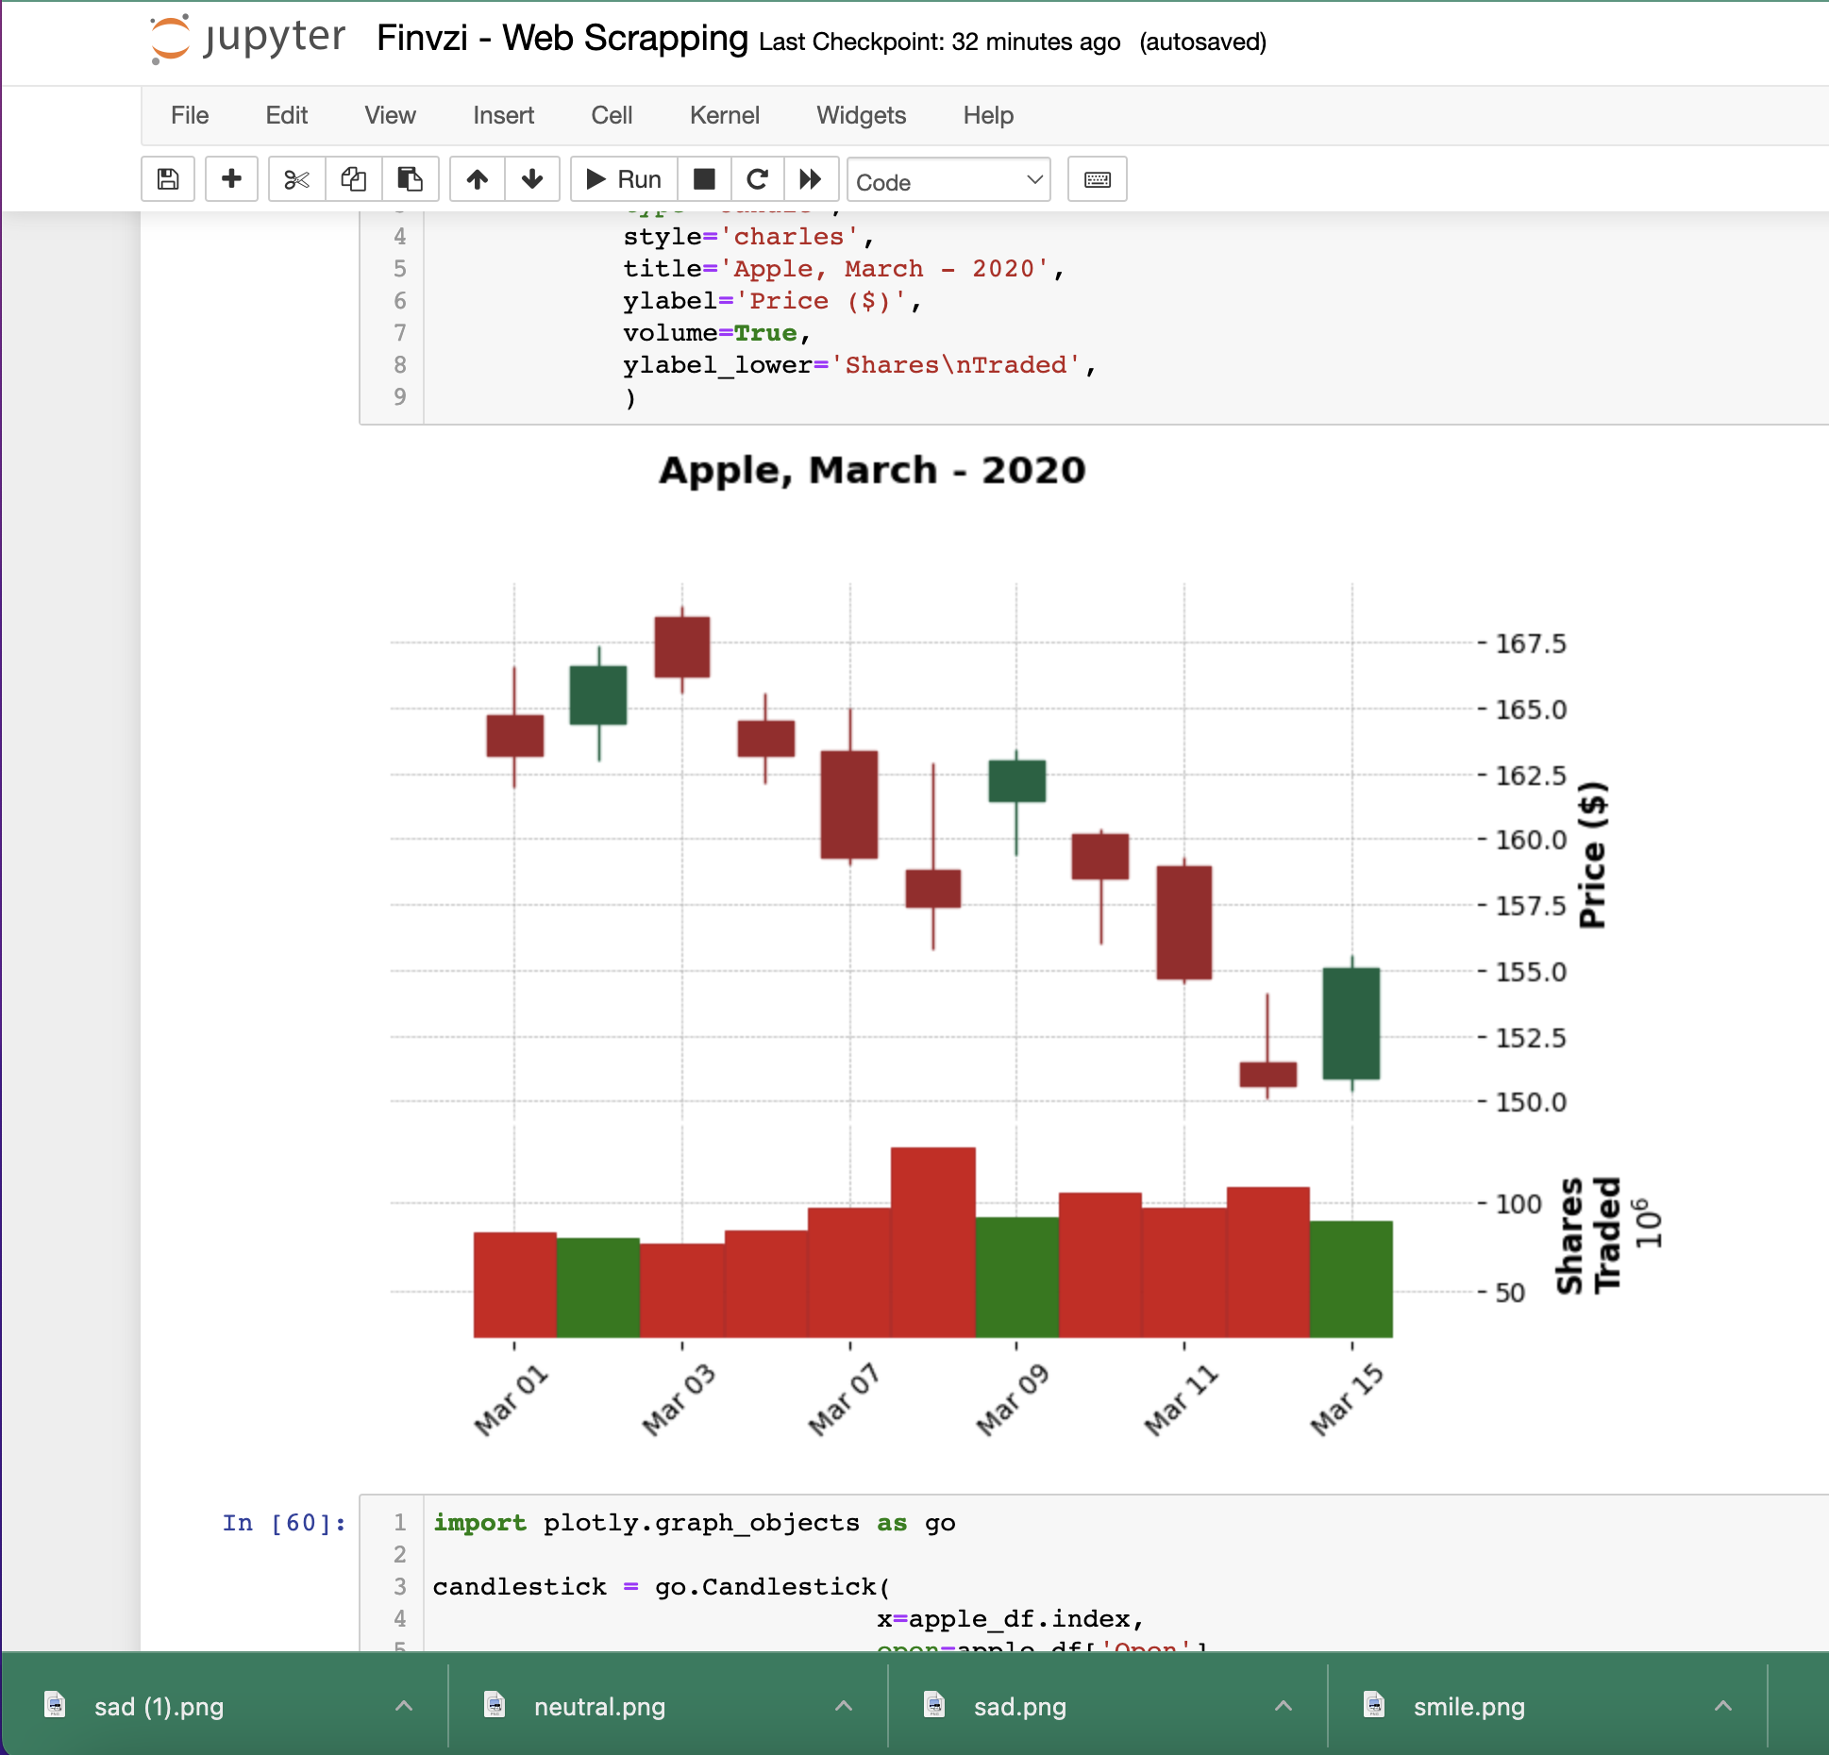
Delivery
Web Scrapping
Date | NTLK Subjective | Textblob Polarity | Textblob Subjective
2022-03-10 | 0.14170 | 0.00959 | 0.10606
2022-03-11 | 0.08182 | 0.05870 | 0.21869
2022-03-12 | 0.28185 | 0.36666 | 0.25000
2022-03-13 | 0.00000 | 0.00000 | 0.08333
2022-03-14 | -0.07610 | -0.0267 | 0.24612
2022-03-15 | 0.083221 | 0.152055 | 0.344694
Price dropped even though the score is positive
More shares are being sold (red) during the same period

Slide 23
Next Steps and Summary
Conclusion

Slide 24



Conclusion
Opportunities/Enhancement
Explore Other Models and Features
App/Web
Development
Potential
Business
Test with other features (especially fundamentals data) to effectively predict the price trend based on the strategy implemented
Provide the model and data in app or web platform to stakeholders for better investment decision making
Ability to build a training bot or trading simulation for general public to paper trade in various brokers (interactive brokers, TD Ameritrade etc)

Slide 25






Conclusion
Demo (Web Platform)
Streamlit (for web application)
Prophet by Meta (Neural Network concept)
Source:
Pandas Technical Analysis Library
Yahoo Finance

Slide 26
Conclusion
Summary
Based on the 3 ML Models (LSTM, BiLSTM, ARIMA), LSTM is the best model in this project context
The model is suitable for short term and mid-long term trading strategy, not for daily trading (as price can fluctuates tremendously within the day)
The model can be tested further with other data (such as company’s financials data) and combine with price history to get a better understanding of the stock price trend.
Other than the stock price history, there are many other factors that will affect the stock price (mostly due to psychological factors and news/social media influence)
With the model, stakeholders can have greater confidence in investing with real cash.
Come out with a proposal of how the trading platform/bot is able to generate revenue for the company

Slide 27

THANK YOU

Slide 28

QUESTIONS

Slide 29
Appendices
https://www.nerdwallet.com/article/investing/what-is-the-stock-market
https://www.forbes.com/advisor/investing/what-is-the-stock-market/
https://www.fool.com/investing/stock-market/
https://towardsdatascience.com/lstm-time-series-forecasting-predicting-stock-prices-using-an-lstm-model-6223e9644a2f
https://unsplash.com/s/photos/rainbow
https://coderzcolumn.com/tutorials/data-science/candlestick-chart-in-python-mplfinance-plotly-bokeh
https://github.com/ArshidSri/Sentiment_Analysis_Summarization_webscrapping/blob/main/Stock_sentiment_Analysis.ipynb
https://www.freecodecamp.org/news/use-python-spacy-streamlit-to-build-structured-financial-newsfeed/
https://github.com/NioushaR/LSTM-GRU-BiLSTM-in-TensorFlow-for-predictive-analytics/blob/master/LSTM%26GRU%26BiLSTM.ipynb
https://neptune.ai/blog/arima-vs-prophet-vs-lstm
https://www.semanticscholar.org/paper/A-Comparative-Analysis-of-Forecasting-Financial-and-Siami%E2%80%90Namini-Tavakoli/acf39918d7ef33a993287bb200a0bb568e742466/figure/0

